Slide 1



GPWT
END-TO-END SPAM DETECTION USING ML IN PYTHON
2024

Slide 2
Hello, everyone
1
2
3
Meet My Team ------
4
5
Farheena
Manasa.N.S
P.Sanjana
6
7
8
9

Slide 3
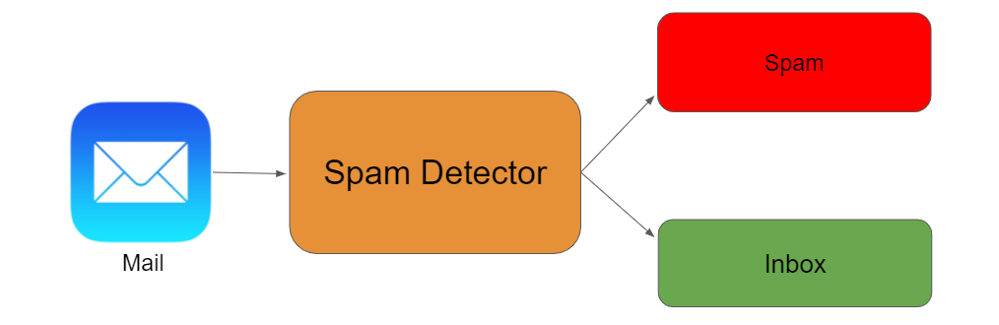
Problem statement ----
1
Building a ML model that can accurately classify incoming messages as either spam or ham.
2
3
4
5
6
7
8
9

Slide 4
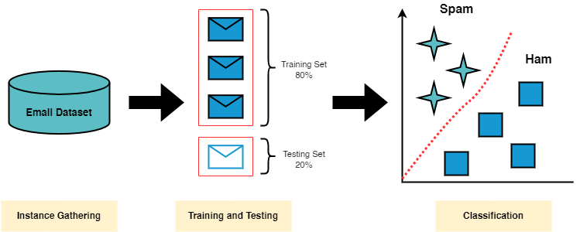
Solution ----
1
Approach :
Data Preparation
EDA
Feature Extraction
Model Training
Model Evaluation
User Interaction
2
3
4
5
6
7
8
9

Slide 5
Technology & Approach ----
1
Technology - Python Programming language.
2
Software - Jupyter Notebook
3
4
Specific libraries used ----
Pandas
Scikit - Learn
Matplotlib
Seaborn
NLTK
WordCloud
5
6
7
8
9

Slide 6
Benefits ------
1
Improved User Experience
Resource optimization
Scalability
Flexibility
Continuous Improvement
2
3
4
5
6
7
8
9

Slide 7
Future Work ----
1
2
Enhancing Feature Engineering
Exploring different ML Algo
Real - time Deployment
Handling of Evolving Spam Tactics
Integration with other Security Measures
3
4
5
6
7
8
9

Slide 8
References ----
1
2
Kaggle
Chat GPT
Gemini ai
Google search Engine
End-to-End Spam detection with python
--- Article by Aman Kharwal.
3
4
5
6
7
8
9

Slide 9

1
2
3
4
5
6
7
8
9

Slide 10

1
2
3
4
5
6
7
8
9

